Slide 1
Stock Data Analysis (Power BI)
Identify the various factors to find the trend analysis in the Stock Data

Slide 2
Problem Statement for Stock Data Analysis
Objective: Perform a comprehensive analysis of the provided stock data to derive meaningful insights for decision-making and strategic planning.
Create a visual report (Power BI/Tableau) by using the data to get meaningful and essentials information.

Slide 3
Recommended Analysis
Descriptive Analysis:
Calculate summary statistics for the 'Open,' 'High,' 'Low,' 'Close,' columns, including mean, median, minimum, maximum, and standard deviation.
Explore the distribution of closing prices ('Close') over the given period.
Trend Identification:
Compute the Exponential Moving Average (EMA) for the closing prices over a selected period (e.g., 10 days).
Identify potential buy or sell signals based on the relationship between closing prices and the EMA.
Performance Metrics:
Calculate daily returns and assess the overall relative strength index (RSI) over the given time frame.
Evaluate the stock's performance in terms of daily price change

Slide 4
Data Overview
date | open | high | low | close | volume | Name
08-02-2013 | 15.07 | 15.12 | 14.63 | 14.75 | 8407500 | AAL
11-02-2013 | 14.89 | 15.01 | 14.26 | 14.46 | 8882000 | AAL
12-02-2013 | 14.45 | 14.51 | 14.1 | 14.27 | 8126000 | AAL
13-02-2013 | 14.3 | 14.94 | 14.25 | 14.66 | 10259500 | AAL
14-02-2013 | 14.94 | 14.96 | 13.16 | 13.99 | 31879900 | AAL
15-02-2013 | 13.93 | 14.61 | 13.93 | 14.5 | 15628000 | AAL
19-02-2013 | 14.33 | 14.56 | 14.08 | 14.26 | 11354400 | AAL
20-02-2013 | 14.17 | 14.26 | 13.15 | 13.33 | 14725200 | AAL
21-02-2013 | 13.62 | 13.95 | 12.9 | 13.37 | 11922100 | AAL
22-02-2013 | 13.57 | 13.6 | 13.21 | 13.57 | 6071400 | AAL
25-02-2013 | 13.6 | 13.76 | 13 | 13.02 | 7186400 | AAL
26-02-2013 | 13.14 | 13.42 | 12.7 | 13.26 | 9419000 | AAL
27-02-2013 | 13.28 | 13.62 | 13.18 | 13.41 | 7390500 | AAL
28-02-2013 | 13.49 | 13.63 | 13.39 | 13.43 | 6143600 | AAL
01-03-2013 | 13.37 | 13.95 | 13.32 | 13.61 | 7376800 | AAL
04-03-2013 | 13.5 | 14.07 | 13.47 | 13.9 | 8174800 | AAL
05-03-2013 | 14.01 | 14.05 | 13.71 | 14.05 | 7676100 | AAL
06-03-2013 | 14.52 | 14.68 | 14.25 | 14.57 | 13243200 | AAL
07-03-2013 | 14.7 | 14.93 | 14.5 | 14.82 | 9125300 | AAL
08-03-2013 | 14.99 | 15.2 | 14.84 | 14.92 | 10593700 | AAL
11-03-2013 | 14.85 | 15.15 | 14.71 | 15.13 | 6961800 | AAL
12-03-2013 | 15.14 | 15.6 | 14.95 | 15.5 | 8999100 | AAL
13-03-2013 | 15.54 | 16.2 | 15.48 | 15.91 | 11380000 | AAL
14-03-2013 | 15.98 | 16.36 | 15.93 | 16.25 | 8383300 | AAL

Slide 5
Data Description
Date- The date activity is been recorded
Open- Opening value of the stock
High- High value(max price) of the Stock
Low- Low value(low_price) of the stock
Close- Closing value of the Stock
Name- Stock Name

Slide 6
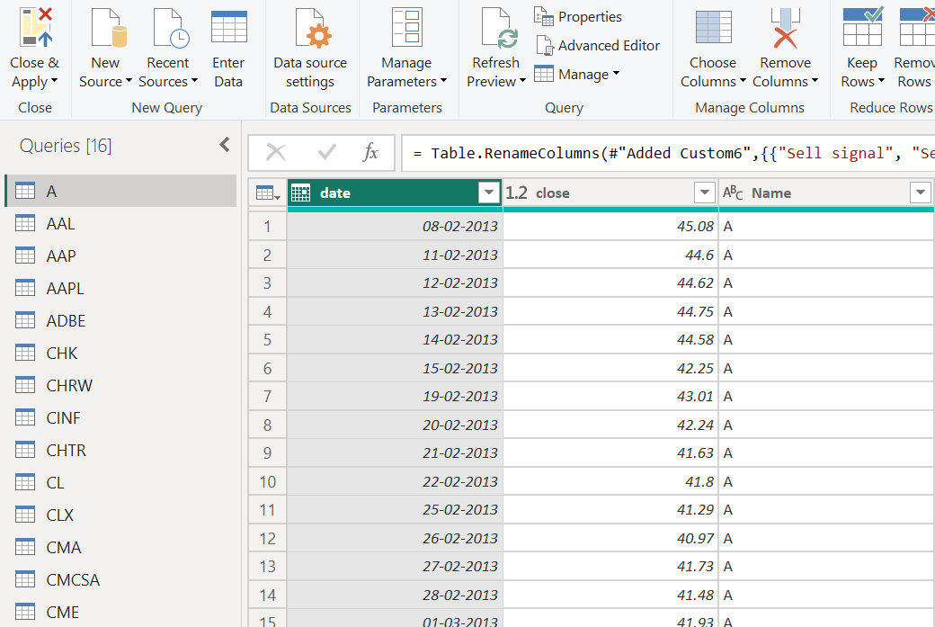
Analysis in Power Query
Imported all 14 stocks data to Power Query . (Date, Close Price, Name only)

Slide 7
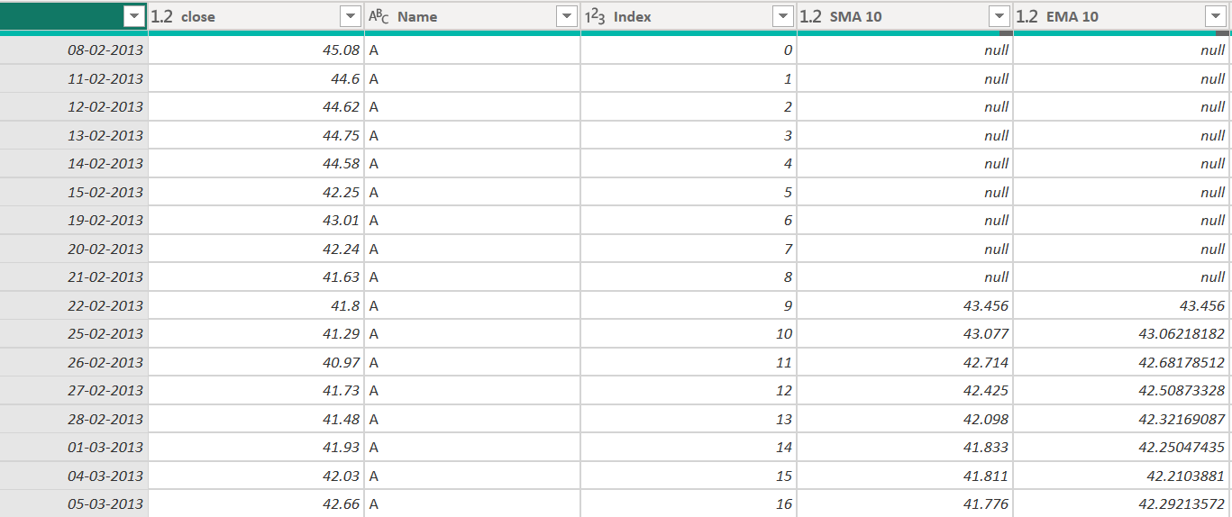
Analysis in Power Query
Adding an Index column ( Add column -- Index Column -- From 0)

Slide 8
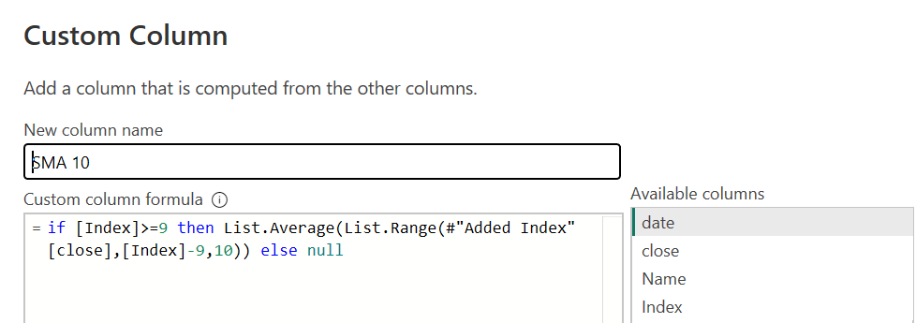
Analysis in Power Query
SMA 10 – Simple Moving Avg of last 10 days
EMA 10- Exponential Moving Avg of last 10 days

Slide 9
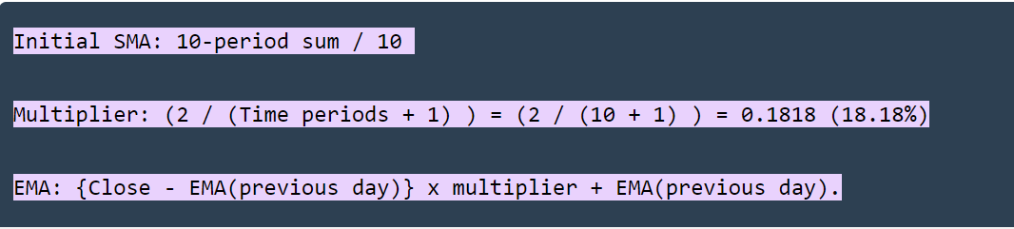
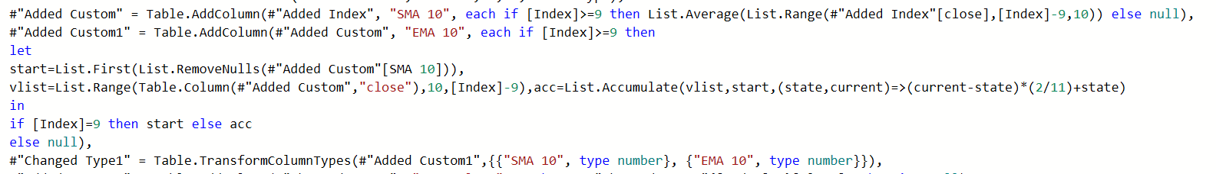
Analysis in Power Query
EMA 10- Exponential Moving Avg of last 10 days

Slide 10
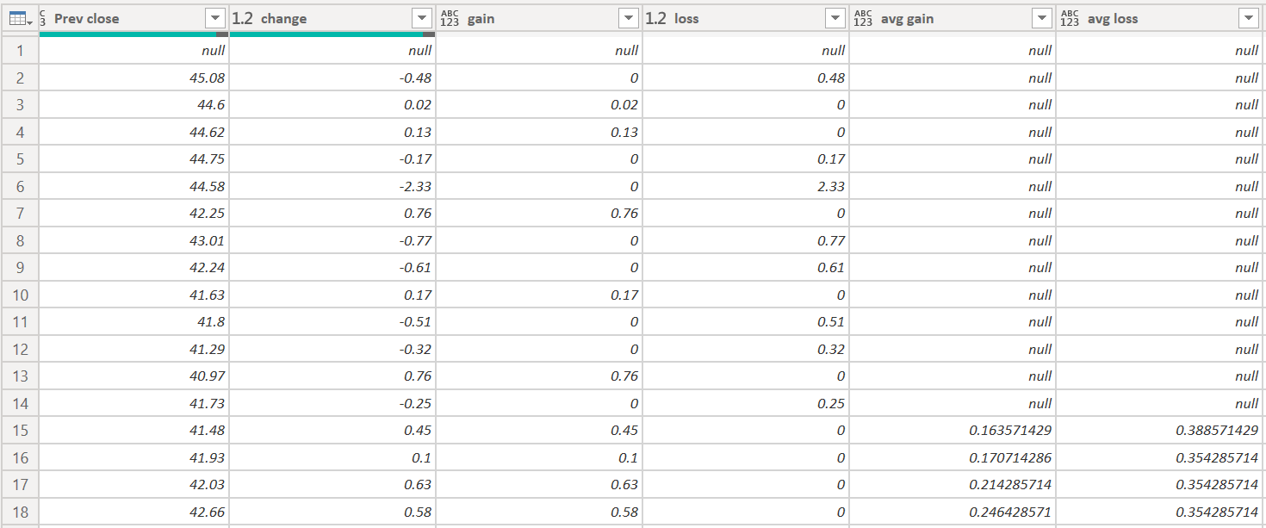
Analysis in Power Query
Calculating average gain and loss in Close Price for last 14 days

Slide 11
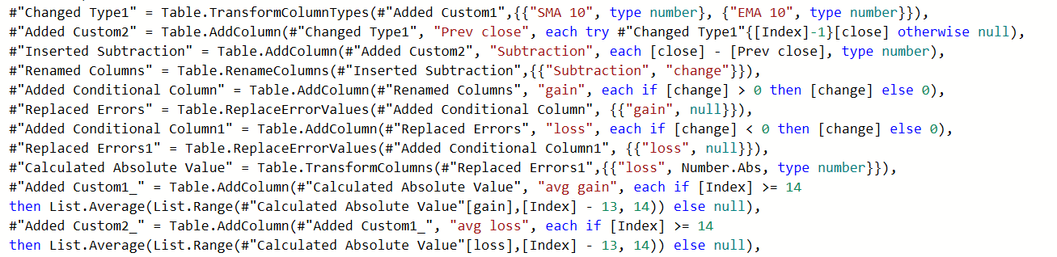
Analysis in Power Query
Calculating average gain and loss in Close Price for last 14 days

Slide 12
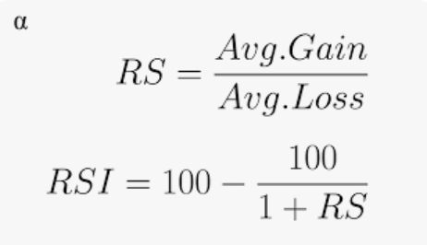
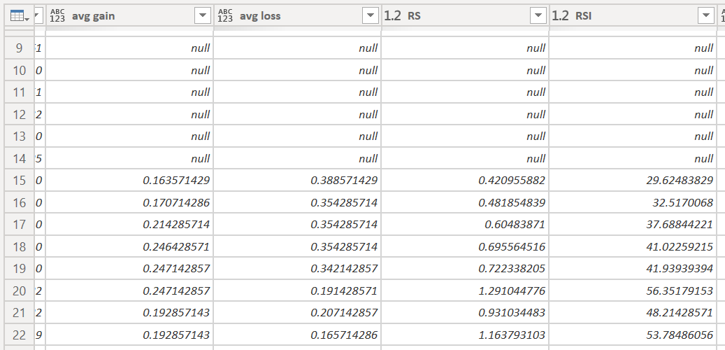
Analysis in Power Query
Calculating RS and RSI

Slide 13
Analysis in Power Query
Calculating RS and RSI

Slide 14
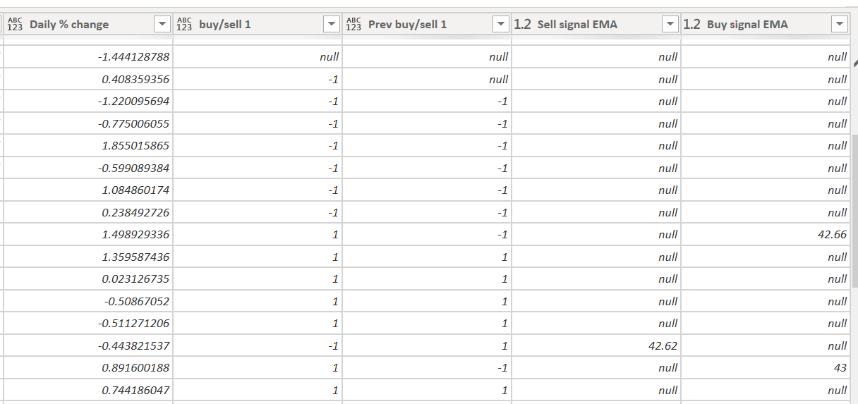
Analysis in Power Query
Calculating Daily % change and Buy/Sell signals for EMA

Slide 15
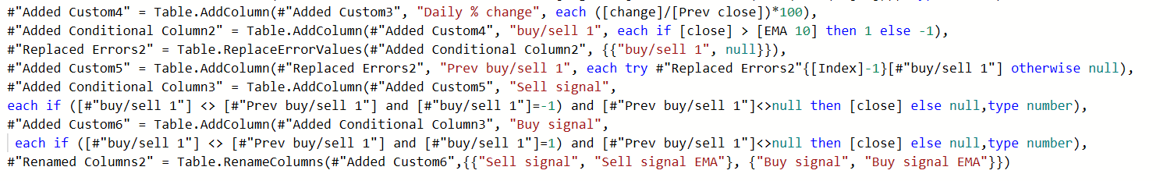
Analysis in Power Query
Calculating Daily % change and Buy/Sell signals for EMA

Slide 16
Analysis in Power Query
Append data for all 14 stocks in 1 sheet (Home – Append Queries as New)
Final sheet with all stocks- all stocks (will do visualization using this sheet)
Back to Power Bi ( close& apply)

Slide 17
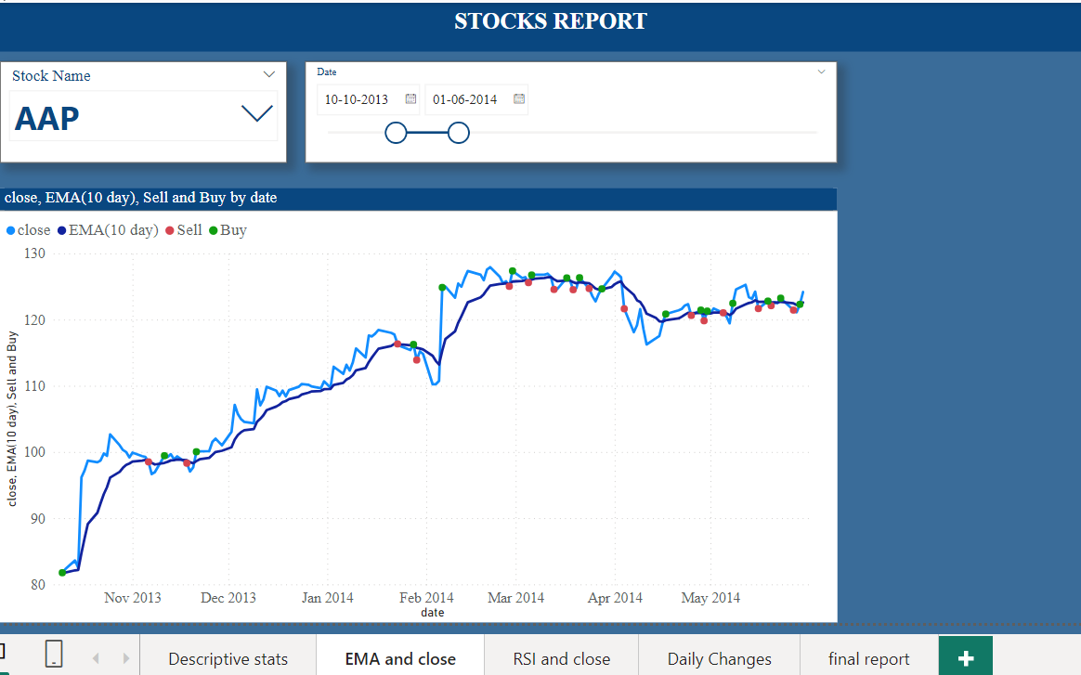
Visualisation

Slide 18
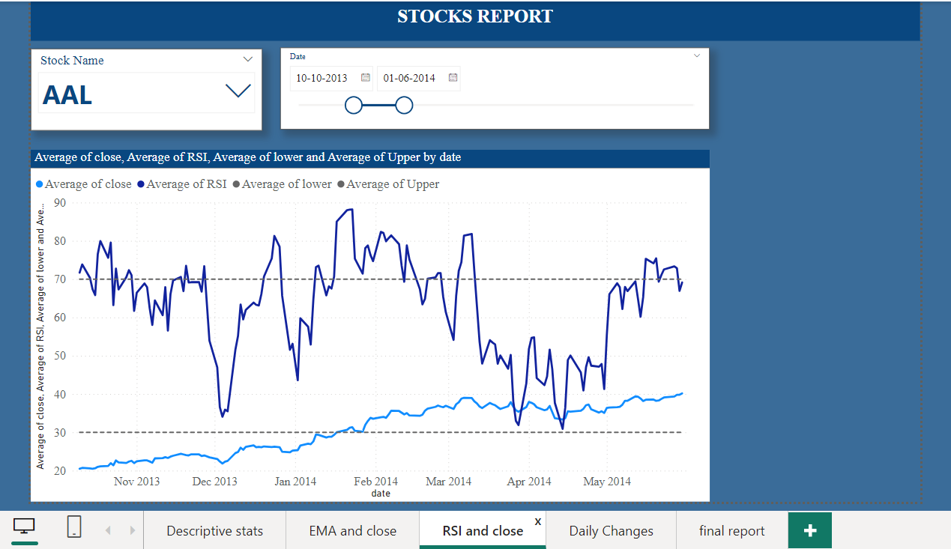
Visualisation

Slide 19
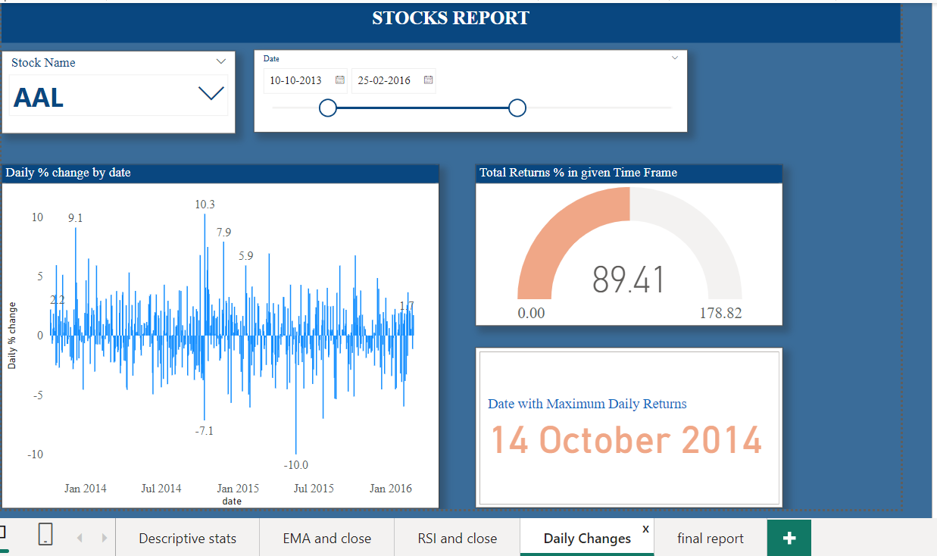
Visualisation

Slide 20
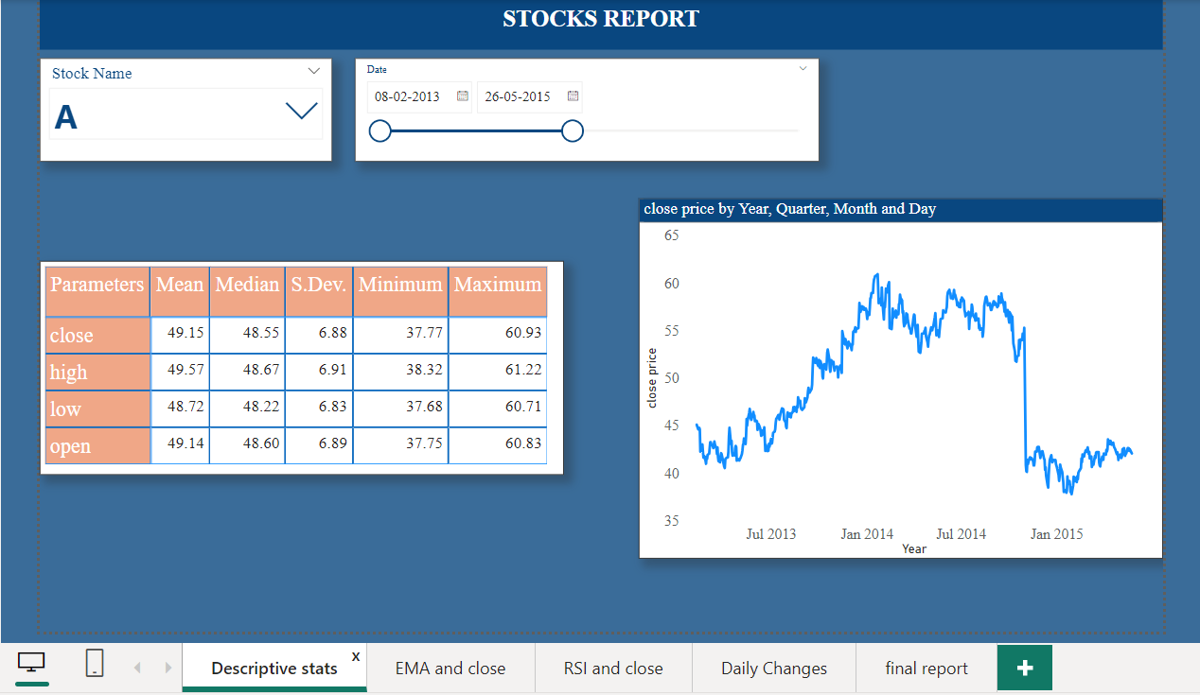
Descriptive Stats

Slide 21
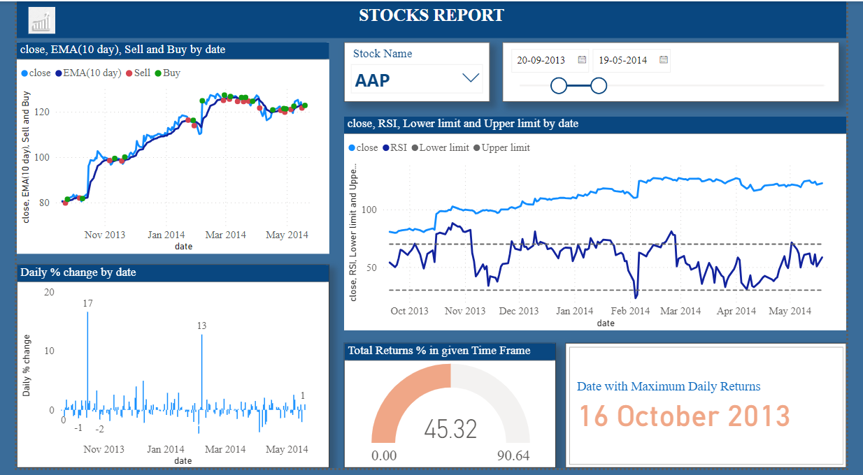
Final REPORT

Slide 22
Thank You

